Slide 1

Cyber Threat Intelligence
Module 4.2
MIS 689
Cyber Warfare
Capstone

Slide 2
Exploring & Collecting Hacker Community Data (Du et al., IEEE ISI 2018)

Slide 3
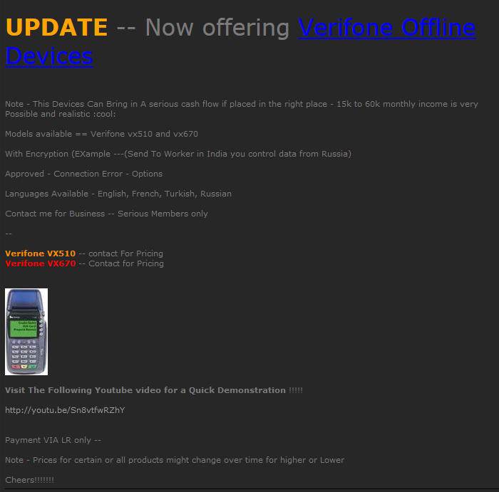
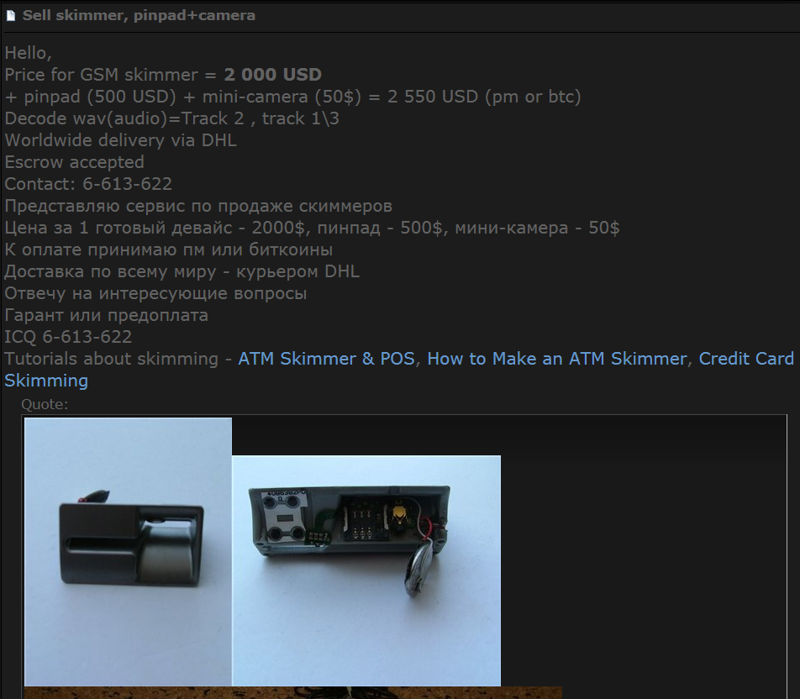
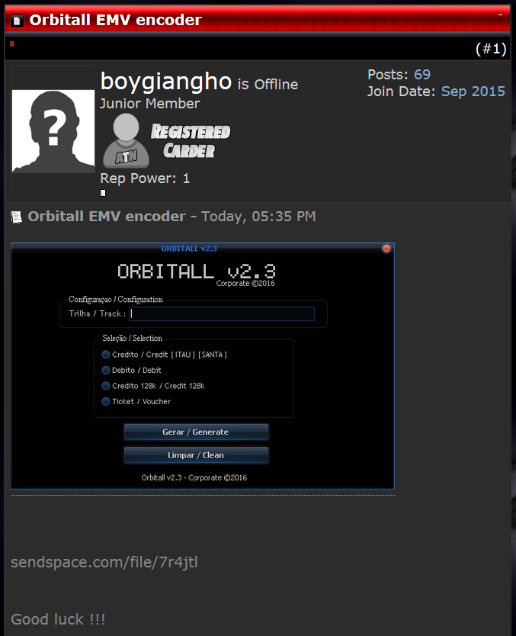
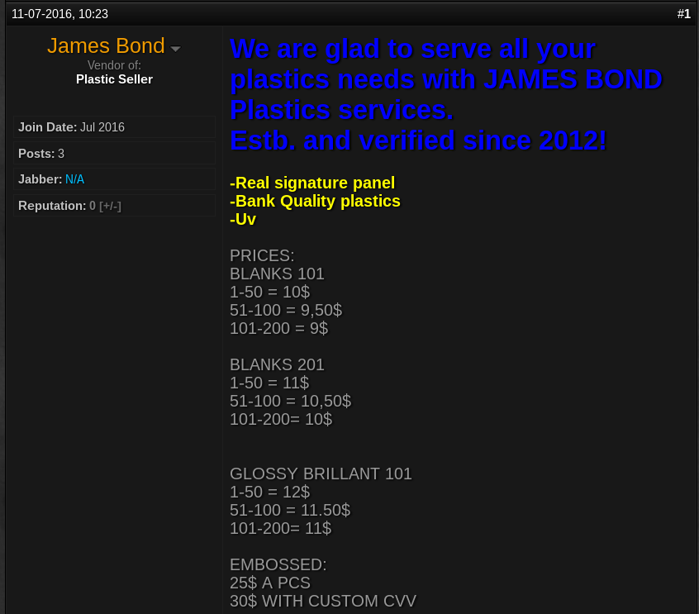
What are in the underground economy?
POS Skimmer
ATM Skimmer
Accessories
EMV encoder
Target POS device: Verifone vx510/vx670
Tutorials
Features
Youtube Tutorials
Sold in batch
Method of Payment: Liberty Reserve
Blank Credit/Debit Cards (Plastics)

Slide 4
Collection Challenges
Anti-crawling measures
IP address blacklisting
User-agent check
User/password authentication & CAPTCHA validation
Denial of service for too many requests
Potential risks of retaliation
Constantly probing underground economy platforms may spook platform owners.
These owners can trace back to us based on network traffic log.
→Need for secure, intelligent collection capabilities

Slide 5
Hacker Community Platforms Overview
Platform | Description | CTI Value
Hacker Forums | Message board allowing members to post messages (archived) | Key threat actor identification; sharing of hacking tools; indication of access to other hacker communities
IRC | Plain-text, instant messaging, communication (not archived) | Sharing of hacking knowledge and potential target; indication of access to other hacker communities
DNMs | Markets on Tor that sell illicit goods via cryptocurrency | Early indicator for breached companies; in-depth understanding of underground economy
Carding Shops | Shops selling stolen credit/debit cards and sensitive data | Monitoring trafficking of internet fraud industry; precaution of breaches before happen
Table 1. Hacker Community Platform Summary

Slide 6
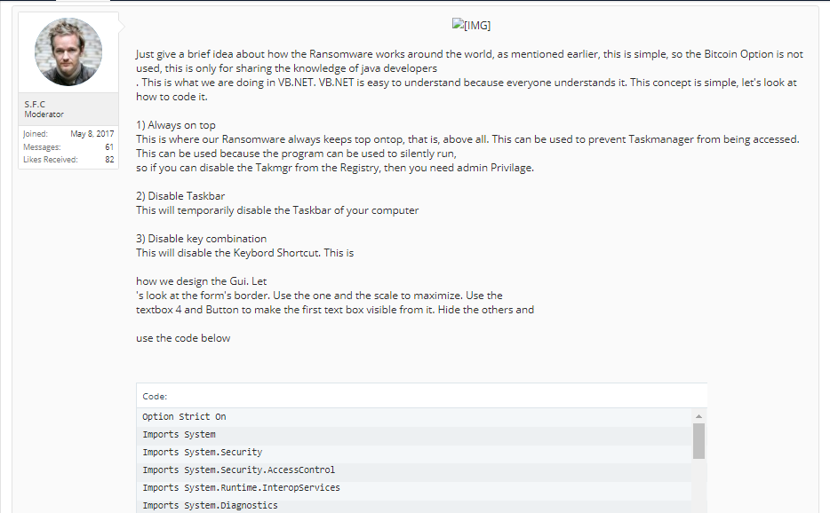
Data Collection Overview: Hacker Forums
Ransomware
description
Poster information
Ransomware code
Figure 1. An example of a hacker forum member sharing ransomware code

Slide 7
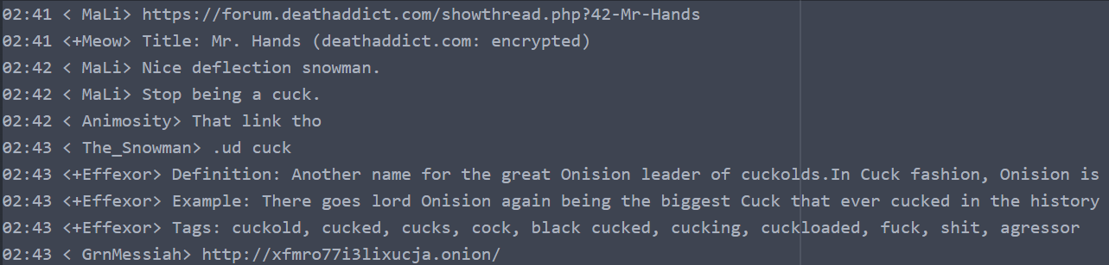

Data Collection Overview: IRC
Figure 2. An example of hackers sharing links containing illegal contents
Figure 3. An example of an IRC user demanding hacking service

Slide 8
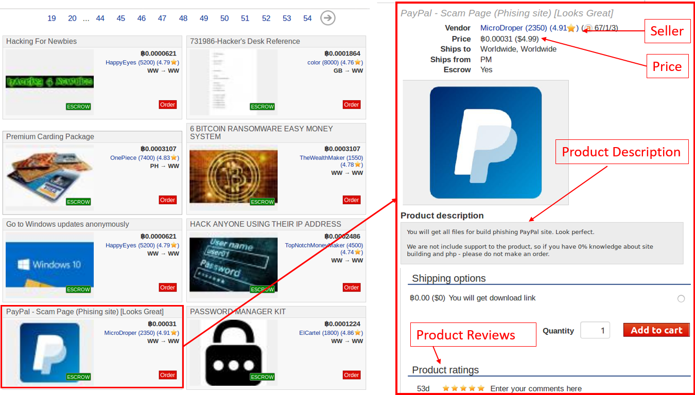
Data Collection Overview: DNM
Figure 4. An example of a product listing page on DNM

Slide 9
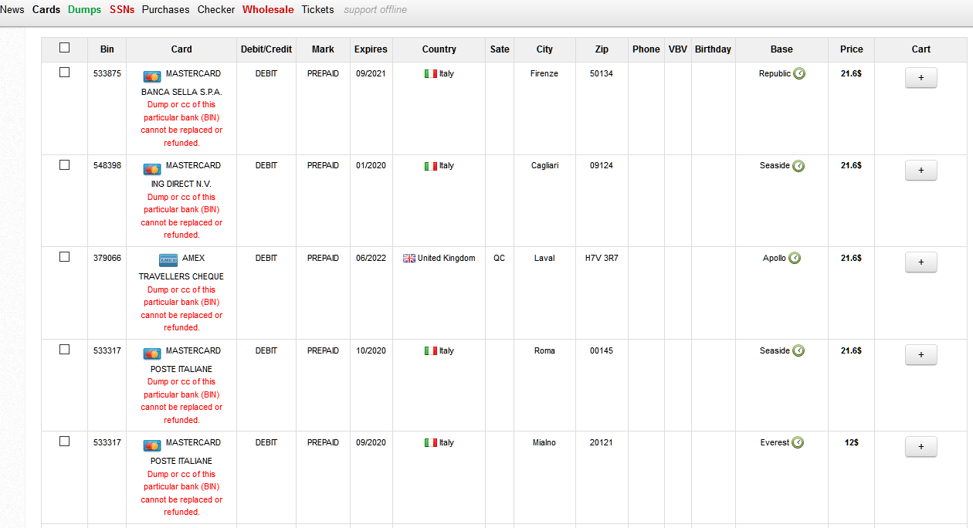
Data Collection Overview: Carding Shop
Card Type
Card detail: Country, City, Price, etc.
Figure 5. An example of listing page on carding shop

Slide 10
AZSecure Data Collection Overview
Platform | # of Platforms | # of Records | Languages
Forums | 51 forums | 32,266,852 posts | English/ Russian/ Arabic
IRC | 13 channels | 2,791,120 lines of conversation | English
DNM | 12 markets | 249,597 listings | English/ Russian/ French
Carding Shops | 26 shops | 8,674,078 listings | English
In our hacker community data collection, we successfully collected 102 platforms for a total of 43,981,647 records.
51 hacker forums,
13 IRC channels,
12 DNMs
26 carding shops
Table 2. Hacker Community Data Collection Summary

Slide 11
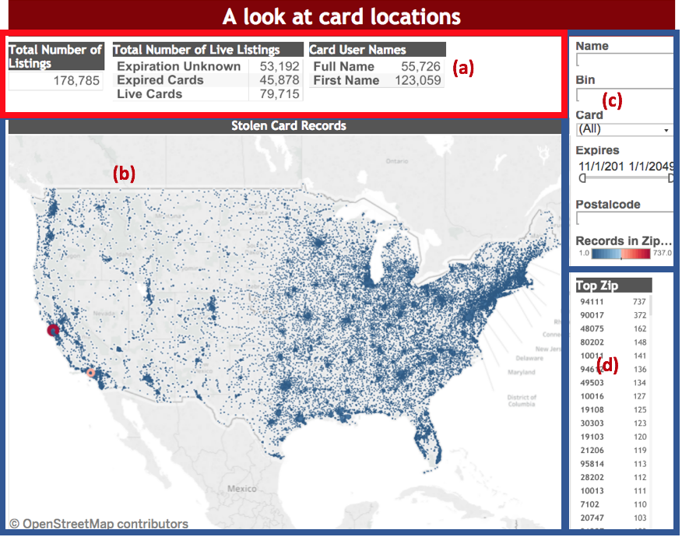
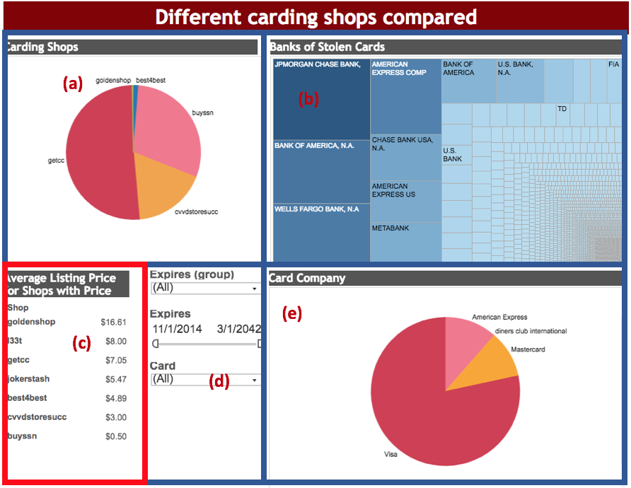
Dark Web Data Integration and Visualization
Figure 7. (a) frequency of cards per shop, (b) banks of stolen cards, (c) average card prices, (d) filter capabilities, and (e) card issuers with most stolen cards
Figure 6. (a) scorecard of active and expired cards, (b) locations, (3) search, sort, and filter functions, and (d) frequency of cards based on zip code

